Slide 1
Theme

Slide 2
In healthcare , the application of traditional machine learning is precision medicine- predicting what treatment protocols are likely to succeed on a patient attributes and the treatment context.

Slide 3
Problem Statement

Slide 4
Build a robust AI/ML services to help people who are in rural areas and where there are pharmacists but not good enough doctors

Slide 5
How to tackle

Slide 6
Web based solution embedded with ML models. These ML models can predict using data provided by the patient. To keep the crucial medical data safe, we store data on Ethereum Blockchain.

Slide 7
Tech stack used

Slide 8
Frontend: React.js,ContextAPI,Ether.js
Backend: Flask
ML Models: TensorFlow, Scikit-learn
Blockchain: Ethereum , Solidity Contract, Deployed on Ropstein

Slide 9
ML model’s accuracy

Slide 10
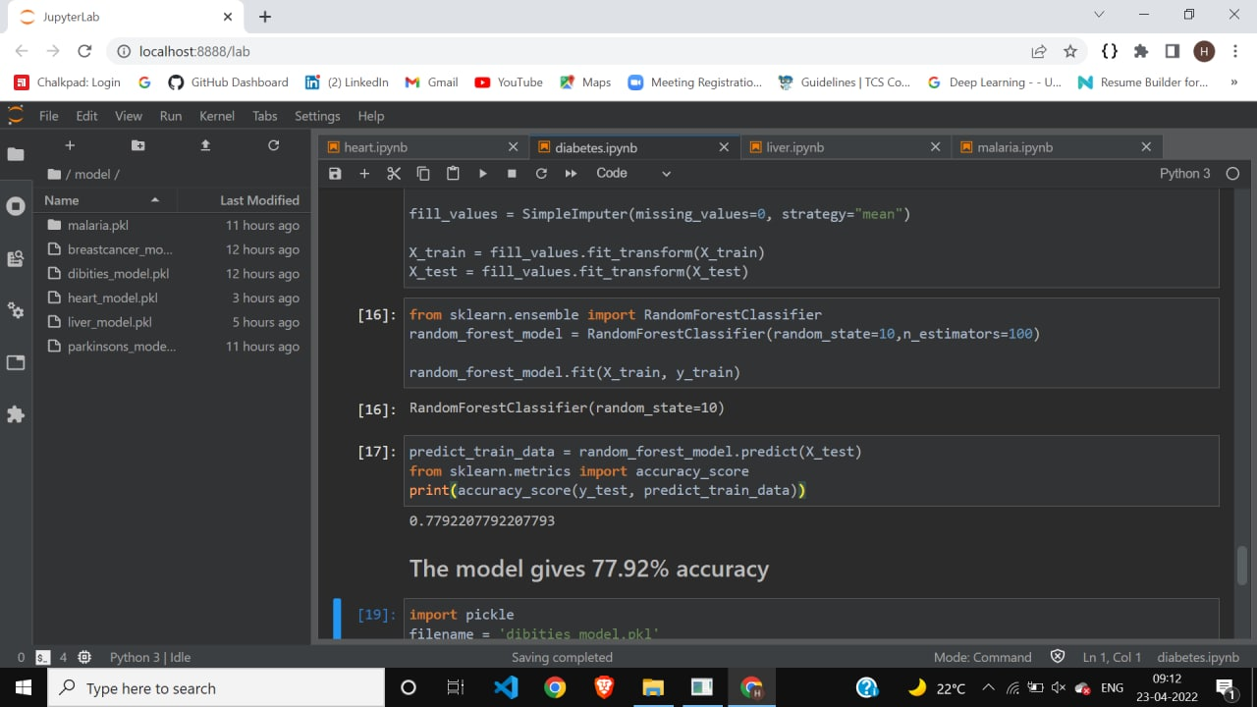
Diabetes ML model’ s accuracy

Slide 11
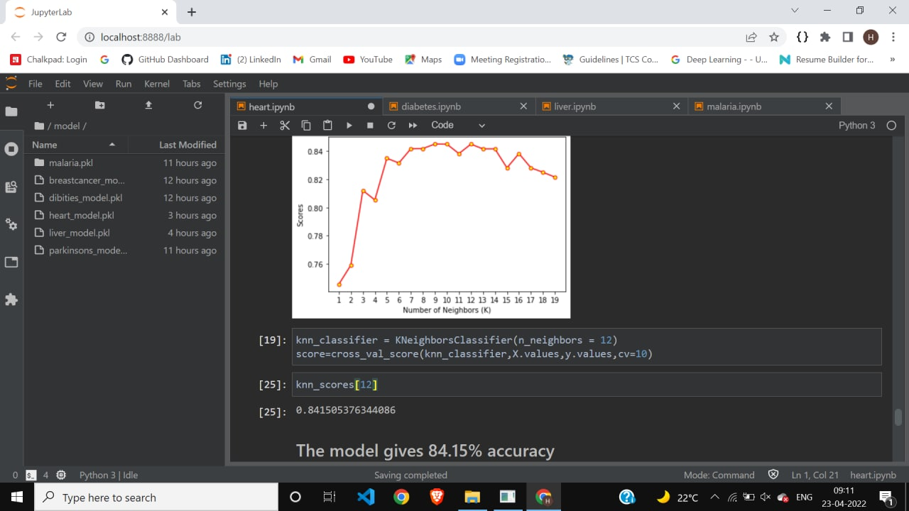
Heart Disease ml model accuracy

Slide 12
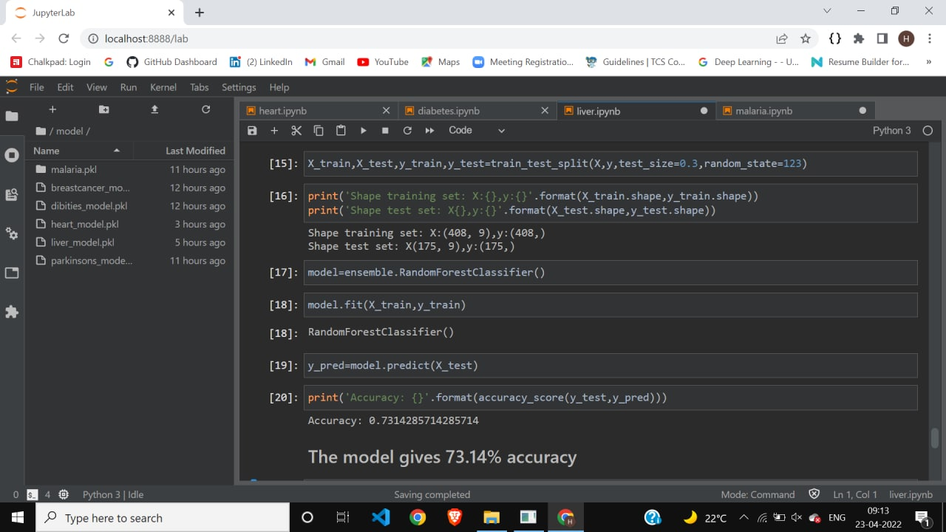
Liver ML Model’ s accuracy

Slide 13
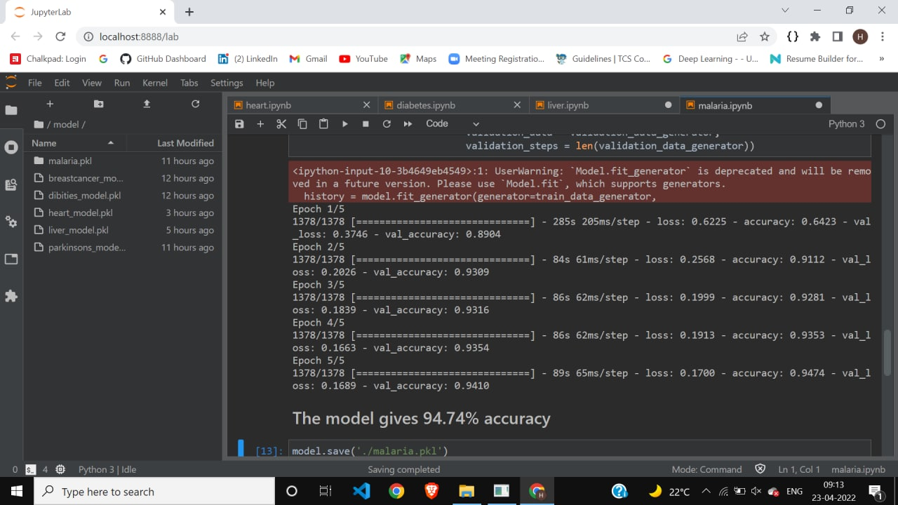
Malaria’s dl model accuracy

